Slide 1



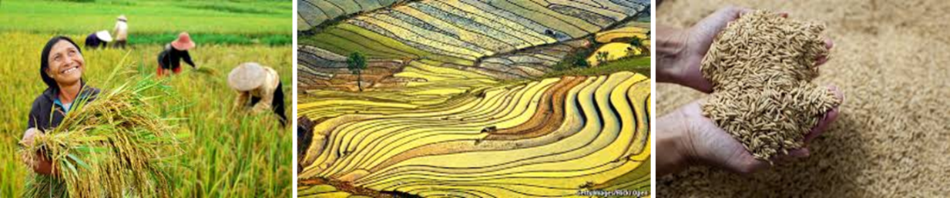
Transforming rice value chains:
The Sustainable Rice Platform
Dr. Wyn Ellis
Coordinator, Sustainable Rice Platform
UN Environment Asia Pacific

Slide 2

Applying an Integrated Approach: THE SUSTAINABLE RICE PLATFORM
Activities | Multi-disciplinary partners | Cross-cutting issues GENDER, HUMAN RIGHTS AND PRIVATE SECTOR
Promoting adoption of pro-poor innovative technologies among rice smallholders to enhance livelihoods | 61 institutional members 10 public sector/research Inter-governmental 30 private sector supply chain actors CSO/CBOs Ministry of Agriculture and Cooperatives, Thailand (MOA) FairTrade (EU) Mars Food Olam International Prime Agri Technologies (Myanmar) WWF, Helvetas (Pakistan) FAO, IFC, UN Environment
 |  | Technologies and Standard development ( SDG17) Multi-stakeholder partnerships (SDG17) Sustainable business practices and reporting” (SDG12) Hunger (SDG 2.1; 2.2) Gender equality among rice farmers (SDG 5.1) Enhance food security and nutrition, focused on smallholders, women farmers (SDG 2.3, 5.1), and agricultural coops/farmers’ networks (2.1,2.2)
Introducing climate-smart best practice for rice production for food security
Ensuring gender empowerment through Rice Sustainability Standard
Collaborating with financial sector to introduce Standards-based financial services for smallholders
Promoting resource-efficient rice production, sustainable procurement and consumer awareness
Introduce innovative technologies to mitigate rice sector emissions, while promoting farm-level resilience to CC impacts
Protecting biodiversity through a systems/landscape approach and through adoption of integrated approaches to pest and nutrient management
SDG 1
POVERTY
SDG 2
HUNGER/FOOD SECURITY
SDG 5
GENDER
SDG 12
SCP
SDG 13
CLIMATE
DG 15
BIODIVERSITY
Notes:
Talking points:
Integrated approach called for in 2030 Agenda- but no exact definition provided by member states
Possible Elements of an integrated approach:
Working across the three pillars of sustainable development/NEXUS approach: Policy, planning and implementation consider the inter linkages between the three pillars of sustainable development – social, economic, environment. Interventions should result in outcomes that support or positively reinforce multiple SDGs.
Policy coherence: policy coherence aims to ensure that the objectives and results of government’s development policies are not undermined by other policies of that same government, and that these other policies support development objectives, where feasible. Given the interlinked and inseparable nature of the SDGs, policy coherence will be even more crucial for any national sustainable development strategy to yield the intended results. It will require strengthening synergies and complementarities across different policy areas so as to meet common and shared objectives.
Integrating environment sustainability national and local planning: Progress in implementing the ambitious 2030 Agenda depends on Member States truly integrating environmental sustainability into national planning and policies, as well as decision-taking processes. This is a prerequisite for sustained, inclusive and irreversible socioeconomic development that eliminates poverty and enhances human well-being.
Integrated financing- mobilize public and private sector financing
Bridging the gap between national, regional and international commitments and priorities: Integrated approach requires that national planning supports (and informs) commitments made at regional and global intergovernmental fora.
Strengthened Partnerships: Need to bring together multi-disciplinary partners. Inclusive and strategic partnerships will be a key feature of implementation at all levels: global, regional, national and local. Issue/Nexus-based coalitions and platforms that integrate diverse and multi-disciplinary stakeholders, including central and local governments, major groups, stakeholders and the private sector are key to implementation, monitoring and accountability of SDGs.
Examples of NEXUS where integrated approach can be applied :
Human Well-being • Healthy Environment
Water and Sanitation • Clean Energy • Food Security
Sustainable Consumption an Production • Sustainable Cities
Healthy Oceans • Trade Opportunities • Pollution
Disasters • Conflict • Migration

Slide 3

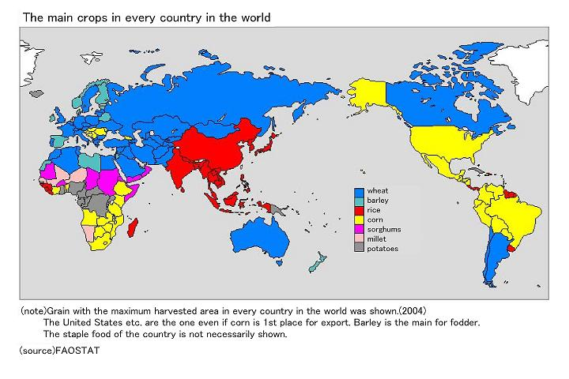
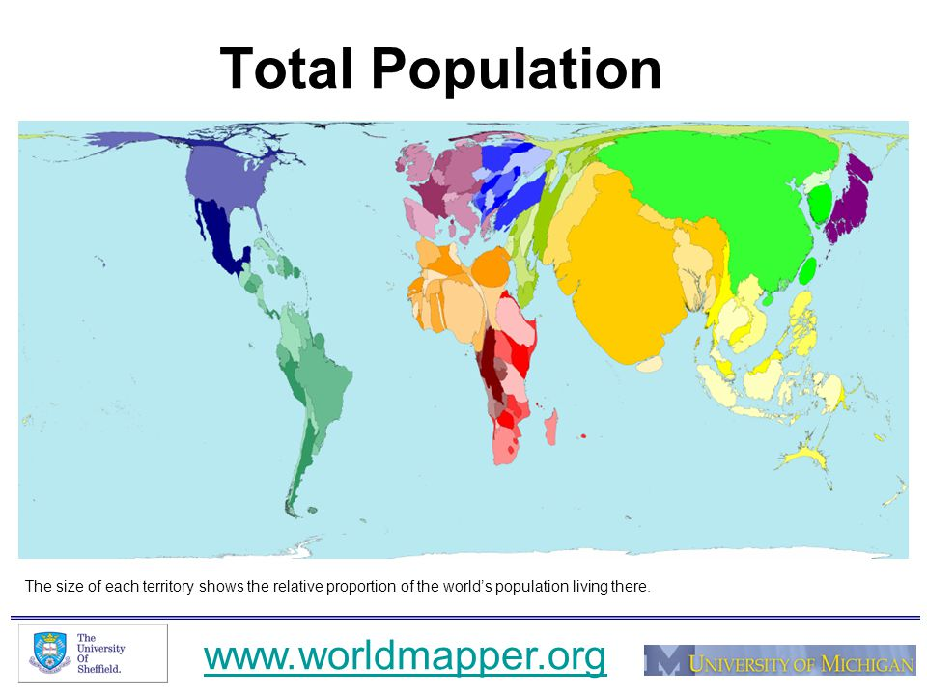
The world eats rice: about 480 m MT per year
19% of global per capita caloric intake
47% of SE Asia per cap caloric intake
29% for all Asia
Staple diet for 50% of the world
Asia dominates global population: Africa accounts for 30% of rice export growth since 1990 and is expected to be the next source of pop growth
Due to its size and cultural appeal rice is not substitutable on a large scale
Source: Olam Rice
Notes:
2030 Agenda and Addis Abba Action Agenda call for an integrated approach- but definition is vague in these documents.

Slide 4
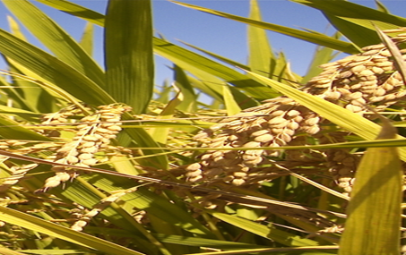
Rice: meeting future demand
“For every 1 billion people added to the global population, an additional 100 million tons of rice needs to be produced every year.”
Source: IRRI
Notes:
2030 Agenda and Addis Abba Action Agenda call for an integrated approach- but definition is vague in these documents.

Slide 5
Production challenges: Rising demand, falling productivity
Slowing growth in production
Diminishing marginal returns to inputs such as N and P
Loss of agricultural land (degradation, conversion, urbanization)
Competition for production factors
Rising energy and fertilizer prices
Climate change - 2050 rice yields will decline up to 20% compared with 2000 (IFPRI/ADB, 2009).
Notes:
What does the future hold?
From 1961 to 2008, the GR led to a tripling in rice yields, big increases in TFP, and made a major contribution to poverty alleviation. And although rice yields are still increasing, the rate of growth has been declining for many years, from a compound rate of 2.5% per year over 1962-1979 to 1.4% per year over the period 1980-2011.
This slowdown leads to diminishing marginal returns to inputs such as fertilizer or energy (Hazell, 2008).
And I’ve listed here some other factors that are also constraining global supply growth in the longer term.
Loss of land from soil degradation, conversion to more profitable crops such as oil palm or rubber, and rapid urbanization and industrialization.
Continued strong growth in production of high-value foods and biofuels is also adding to competition for producit9nn factors such as land, water, fertilizers and energy.
Higher costs of those inputs, especially energy and fertilizers, make it difficult do justify their use on a low-price commodity such as rice.
And last but not least, climate change, to which SEA is extremely vulnerable. According to IFPRI and ADB, crop yields in 2050 will decline from 2000 levels by up to 20 % for rice, 13 percent for soybean, 16 percent for wheat and 4 percent for maize in East Asia and the Pacific (IFPRI/ADB, 2009).
Notes:
Reasons include (1) displacement of cereals on better lands by more profitable crops such as groundnuts and horticultural crops, (2) diminishing returns to modern varieties when irrigation and fertilizer use are already high, and (3) falling cereal prices relative to input costs, which makes additional intensification less profitable.
Rapid urbanization, industrialization and development of infrastructure in many Asian countries have further limited the scope for bringing new good agricultural land into cereal production. New sources of irrigation water are also limited, while nonagricultural uses of water for urban, industrial, and environmental purposes are growing rapidly. Increasing rice production is constrained not only by worsening land and water scarcities but also rising energy and fertilizer prices. Continued strong growth in the production of high-value foods and biofuels is also adding to the competition with cereals for land and water. Climate change will exacerbate the problem by adversely affecting yields and increasing evapotranspiration.
All these factors will potentially affect the relative competitiveness of Asian versus West African rice systems (Adjao and John M. Staatz, 2013)
Production of sufficient rice in Asia at an affordable price for the poor relies on effective fertilizer use, esp. in irrigated lowlands producing 75% of Asia’s rice (Source: Buresh & Witt, 2008)

Slide 6
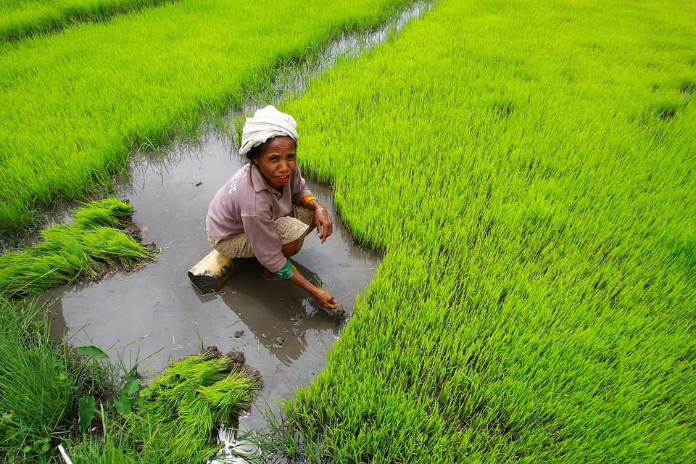
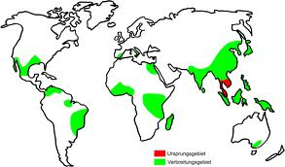
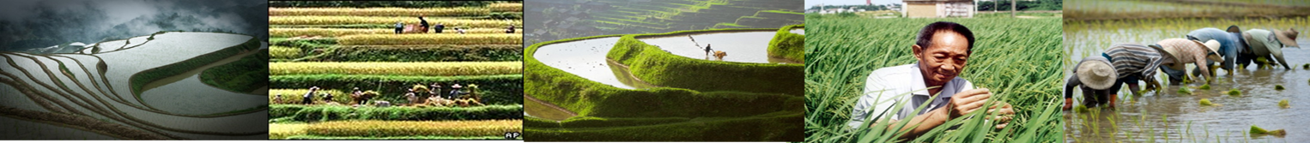
Rice sustainability challenges
• Resource use efficiency (land, water, agrochemicals, labour);
• GHG emissions (CH₄, N₂O, CO₂);
• Impacts on ecosystem services;
• Soil impacts (e.g. salinization, arsenic, organic matter);
• Disease impacts (e.g. water-borne pathogens);
• Climate change impacts
Notes:
While flooded paddy rice production is considered an essentially sustainable system that maintains long-term soil fertility and continuous high productivity (Dobermann, Witt and Dawe, 2004), sustainability concerns in rice production systems can be generally categorized as follows:….
These issues have already been extensively documented in the literature (see overview by Bouman et al., 2007). Use of resources (particularly water and agrochemicals) and GHG emissions from rice paddies are of particular concern. Globally, about 100 million ha (harvested) rice area are irrigated (Dawe, Pandey and Nelson, 2010), accounting for some 34–43 percent of the world’s irrigation water (Bouman et al., 2006). The imperative for improving water-use efficiency is further sharpened by increasing incidence of local water scarcity, even in irrigated rice areas. Tuong and Bouman (2003) estimated that by 2025, 15–20 million ha of irrigated rice will suffer some degree of water scarcity.
Total fertilizer consumption has increased for most countries in the last 50 years, and this is probably also the case for rice (Gregory et al., 2010). Based on the most recent crop-specific fertilizer consumption statistics, the world’s rice fields receive some 15 percent (or 24.3 million tonnes) of global fertilizer (N + P2O5+K2O) use – the same amount as the world’s wheat and maize fields. Total N use stands at 15.7 million tonnes, P2O5 at 4.8 million tonnes, and K2O at 3.8 million tonnes (Gregory et al., 2010). Country averages vary from more than 200 kg/ha in countries such as China and Viet Nam, to less than 100 kg/ha in the Philippines and Thailand (IFA, 2009; cited in Gregory et al., 2010). The health and environmental impacts of excessive use of fertilizers in intensive systems are compounded by low fertilizer use efficiencies; poor application timing can result in only 20–40 percent or less of applied nitrogen fertilizer captured by the crop (Islam, Bagchi and Hossain, 2007).

Slide 7
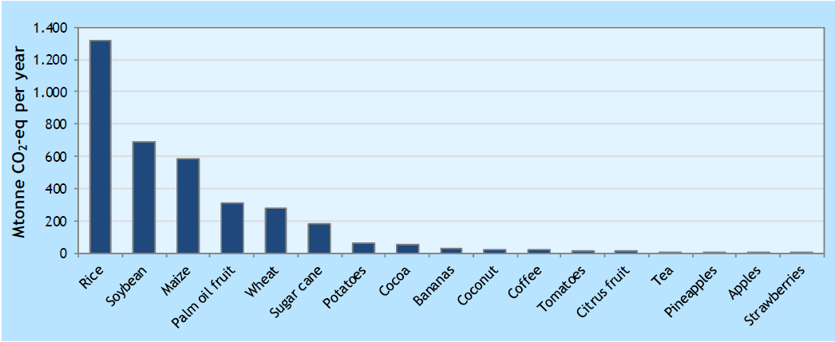
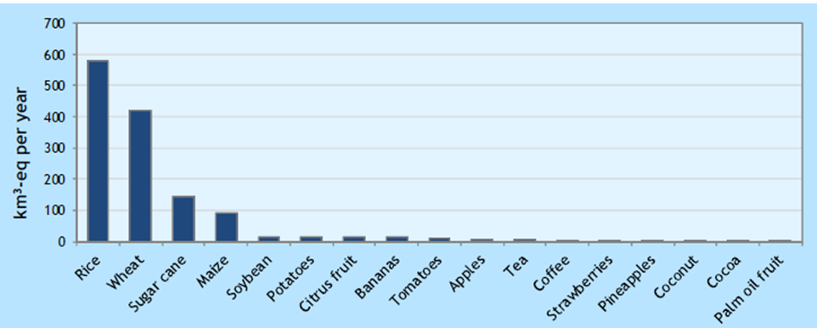
Annual global GHG footprint per commodity:
Annual global water scarcity footprint per commodity:
Source: Oxfam, 2016

Slide 8
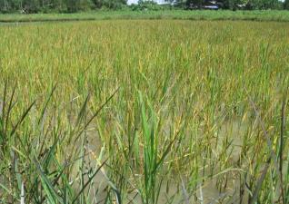
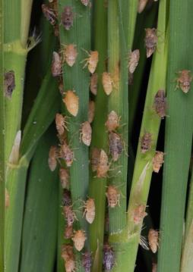
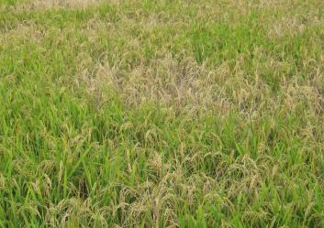
Pesticide use: 0.4-3.8 kg a.i./ha
Ecological breakdown
Virus diseases
BPH outbreaks
Hopper burn
China, Thailand, Vietnam, Korea, Japan,…
Notes:
Pesticide use is also a major issue, with inappropriate use leading to widespread environmental and human health impacts.

Slide 9
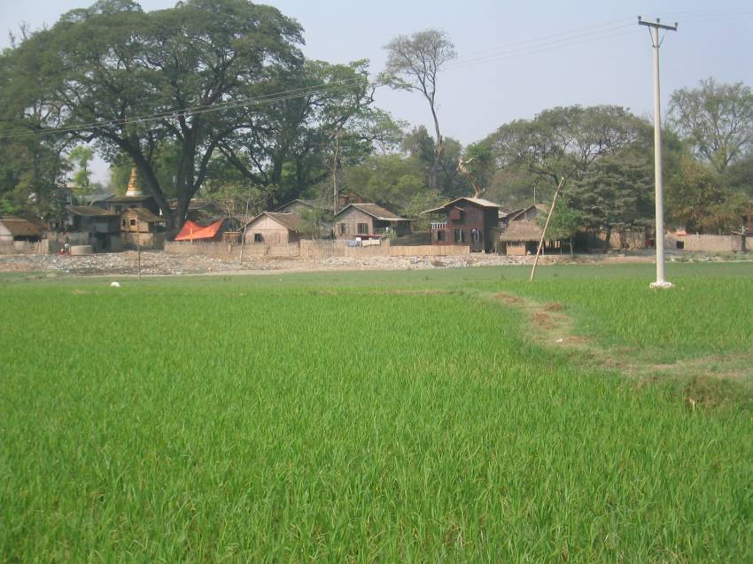
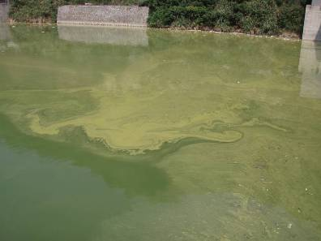
Fertilizer N use: from 25 to >250 kg/ha/season
Too little…
Too much…
Mandalay, Myanmar
Notes:
Fertilizer use efficiency is generally very low and its use is generally far from optimal.

Slide 10
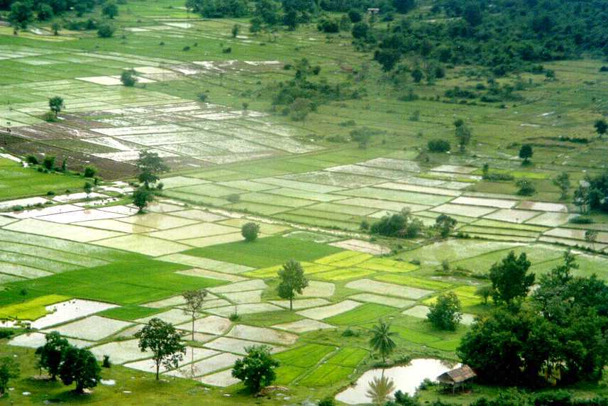
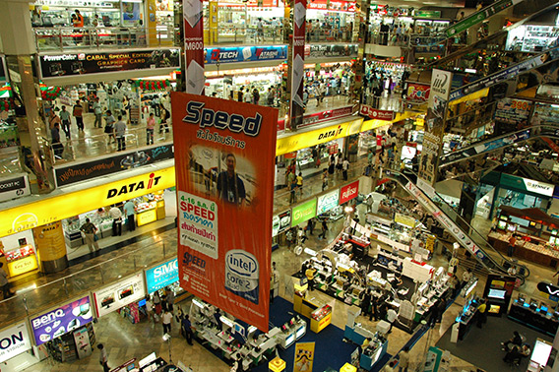
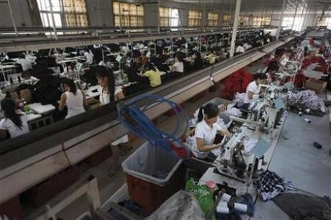
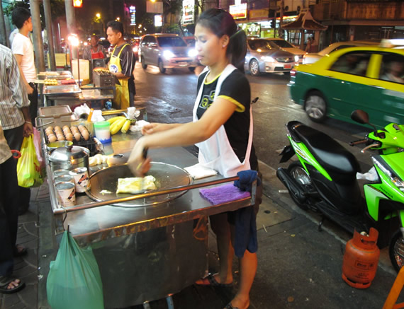
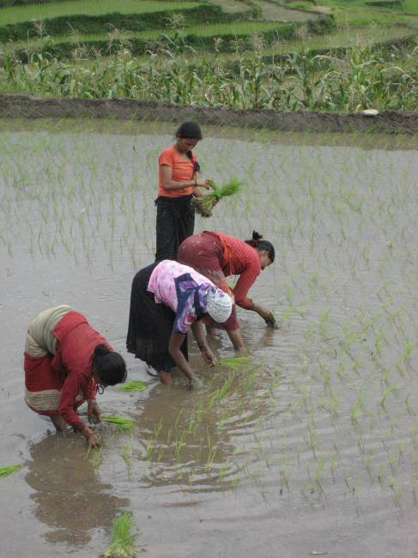
Pressure on Labour
Rice fields represent 15% of the world’s wetlands
Irrigated rice fields are the richest agro-ecosystems for waterbirds (van der Weiden et al., 2010)
Notes:
And finally, intensification has led to loss of some unique habitats.

Slide 11
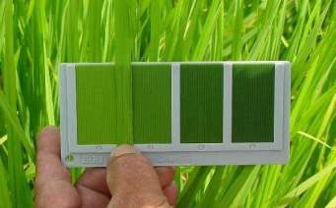
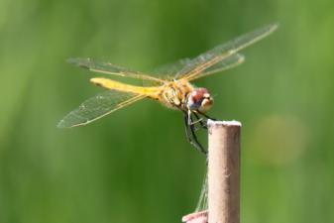
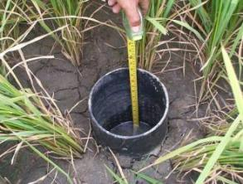
Proven climate-smart technologies
Site-specific nutrient management (SSNM)
Alternate wetting and drying (AWD)
Integrated Crop Management (ICM)
Integrated Pest Management (IPM)
Resource-Conserving Technologies (RCT)
ICT- GIS applications

Slide 12
Mobilizing the rice value chain
We need.....
A credible, robust and feasible ‘standard’ or ‘sustainability toolkit’ available for farmers, that serves to define sustainability in rice and provide a normative framework for policymaking
A mechanism for passing benefits through the value chain and drive widespread adoption
Notes:
However, in order to actually get these approaches and best practice technologies from research to field, we need to mobilize the supply chain and also create an enabling policy framework that incentivizes adoption.

Slide 13

The Sustainable Rice Platform
Notes:
And that is the basic premise for establishing SRP

Slide 14
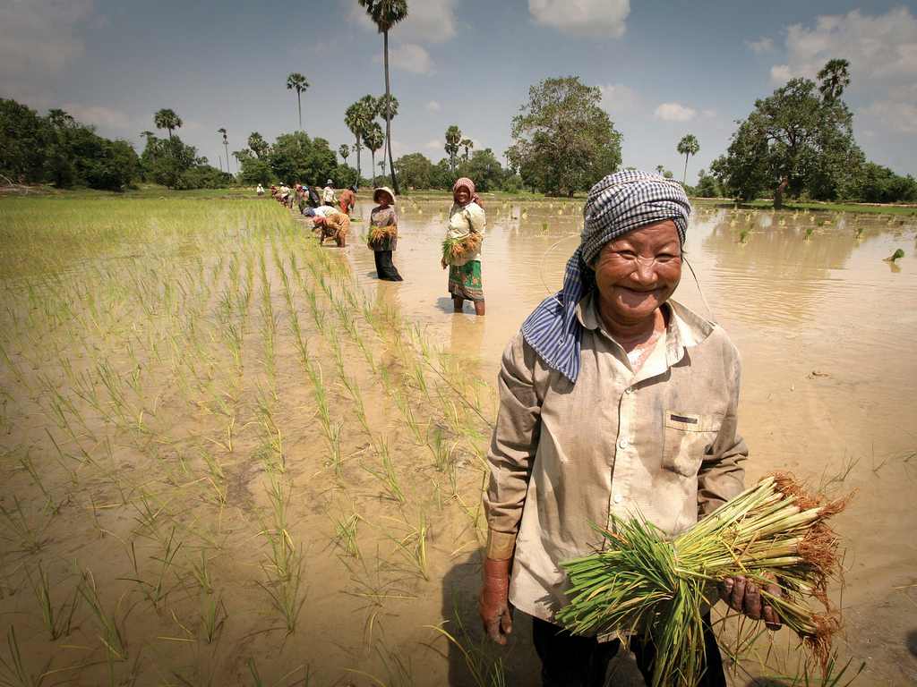

Goal: 1 million farmers adopt climate-smart sustainable best practices within 5 years (2016-2021)
© MARS FOOD | CONFIDENTIAL

Slide 15
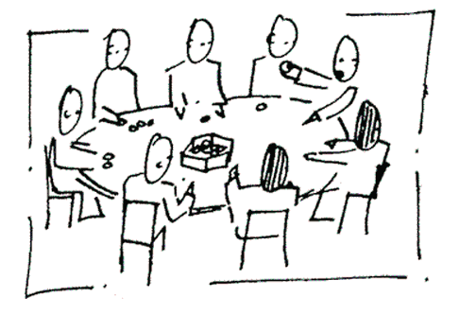
A global multi-stakeholder partnership to drive impact
65 institutional members
International Orgs
UNEP, FAO, IFC
Governments
CAM, INDO, Lao PDR,
PHILS, SL, TH, VN
NGOs
Rainforest Alliance, FairTrade, Wildlife Conservation Society, Solidaridad, WWF
Research
IRRI, Punjab Agricultural Univ, Sri Lanka Rice R&D Institute, NACA, NAFRI (Lao PDR), INPI
Input suppliers
BASF, Bayer, Syngenta, Dow, IFA
Food industry Ahold, Mars, Ebro
Producer Groups
Nestle Paddy Club Malaysia
Traders/Importers
Ebro, Louis Dreyfus Commodities, Olam International, Tilda, van Sillevoldt Rijst, Westmill, Veetee

Slide 16

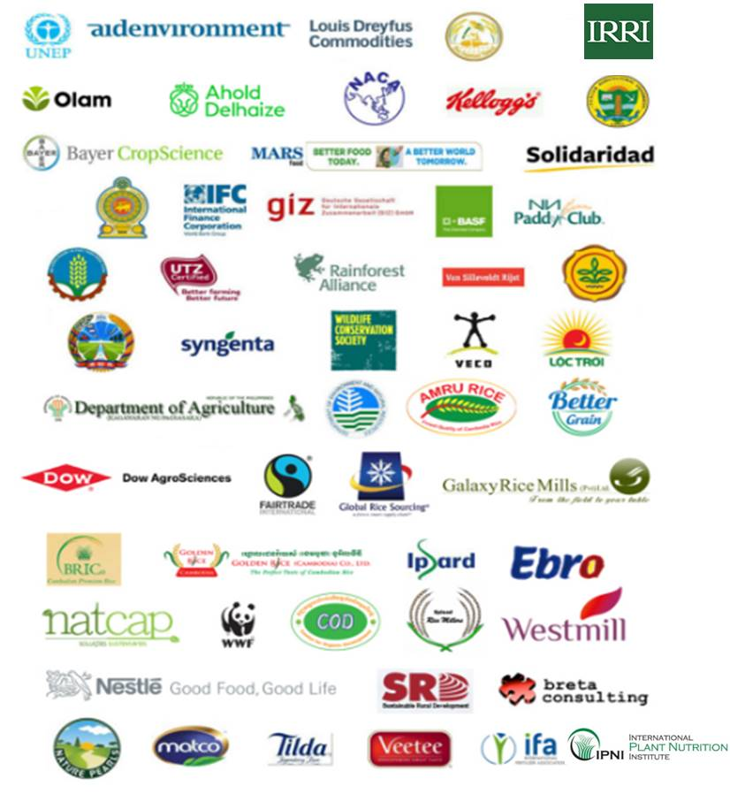


SRP institutional members
16

Slide 17
The building blocks…
Goal: 1 million farmers adopt climate-smart best practice
Supply chain governance
Public sector engagement
Standard
Assurance & communication
Public regulation & support policies
Incentive mechanisms
Business case
Farm level
Supply chain level
Ecosystem services
Capacity building
Decision-making tools
Training modules
Outreach models
Knowledge hub
Awareness raising
Monitoring, evaluation & learning
Performance measurement
Impact measurement
Proxies / levels

Slide 18
Driving best practice: the SRP Standard and Performance Indicators
Distribution: Members’ Area of SRP website (brochure format also available)
Translation: Vietnamese, Thai, Khmer, French
Supported by SRP data collection and aggregation tools
Communication and Assurance Guidelines for Pilot Phase
Training materials

Slide 19
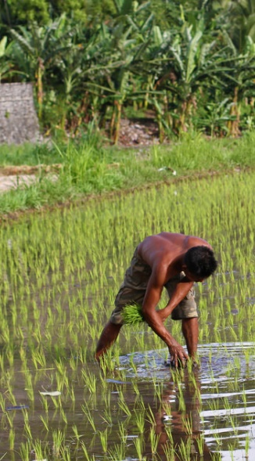
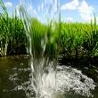
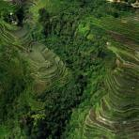
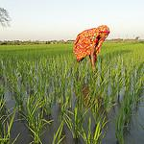
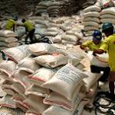
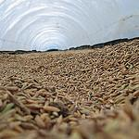
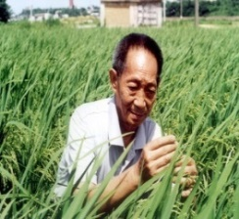
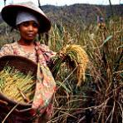
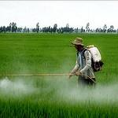


SRP: World’s first rice sustainability standard
The Standard covers the following 8 themes:
Water use
Nutrient management
Pre-planting
Health & safety
Harvest &
post-harvest
Farm management
Labour rights
Pest management
Photos: image collection of
the International Rice Research Institute (IRRI)
©FLICKR
Notes:
We developed the first and so far only standard for rice cultivation. Addressing specifically the needs and the challenges of rice, which makes it different than the other initiatives that have a generic standard for all crops.
Why a Standard?
Standard makes the sustainable claim credible and tradeable. It helps communicate the claim throughout the supply chain: from producers to buyers.
And in that way creates value for all the parties, economical, reputational and societal environmental
SRP rice standard aims for yield increase, with respect for the environment and society
It was designed based on the agricultural cycle and it is applicable at a global level. So all of you who produce in Europe can use it as a differentiator in your markets.
It covers areas as:
Pre planting
Human rights
Health and Safety
Soil fertility
Pest and Weed control
Harvest and post harvest activities
Water usage

Slide 20
A compact standard
Relevant
Versatile
Understandable
Practical
Notes:
RA – almost 160
UTZ – 120
SRP – 46

Slide 21
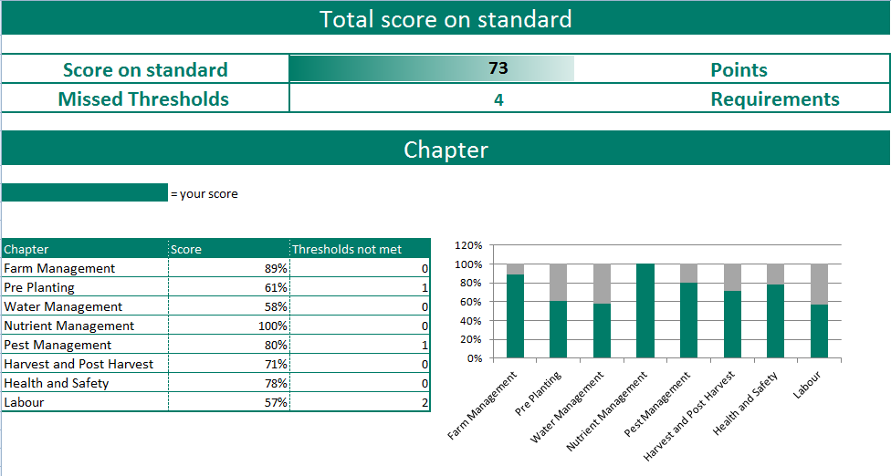
SRP Standard and Indicators: Measure the sustainability of any rice system

Slide 22
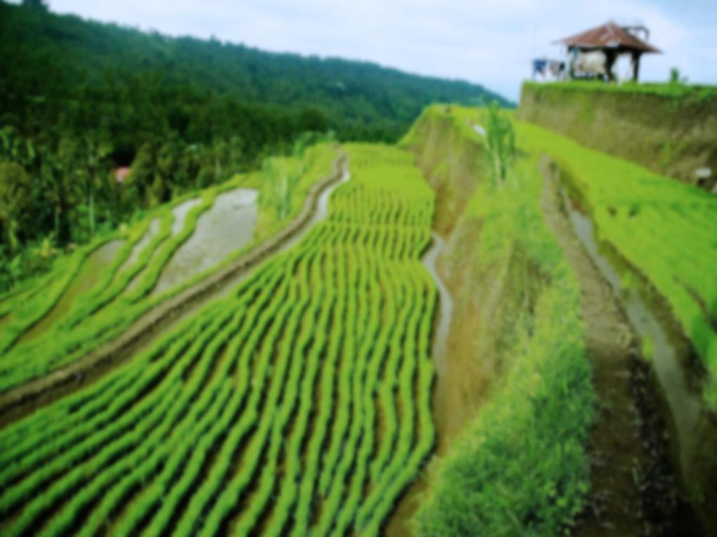

SRP development trajectory
PROOF OF CONCEPT
2015-16
UPSCALING
2017 - BEYOND
START – UP
2011- 2014
Standard development
Piloting and Implementation
Roll out- Assurance
Upscaling
Policy dialogue
Notes:
Since its start in 2011, the SRP has gone through different development stages:
Start up – creation of standard
Proof of concept-
Look forward to broaden through new partnerships to scale up and roll it out globally

Slide 23
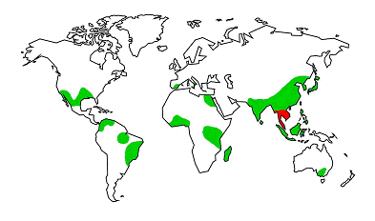
Multi-country field validation programme
Pakistan
India
Thailand
Uganda
Vietnam
Brazil
Cambodia
Sri Lanka
Total Y1: <5,000 ha
Total Y2: ~20,000 ha
Notes:
These are the locations for the multi-country field trials that- currently around 2,000 ha, that are currently ongoing. Mostly in S and SEA, but also in Uganda and some large farms in Brazil too. Next year we expect to see an expansion to 7,000 ha.
Following the launch of the Standard, and the commitment by Mars to 100% sustainable sourcing for all its rice by 2020, we are seeing a clear uptick in interest among European buyers in purchasing sustainable rice, which in turn has translated into corresponding upstream interest among their own suppliers as well as competitors.

Slide 24
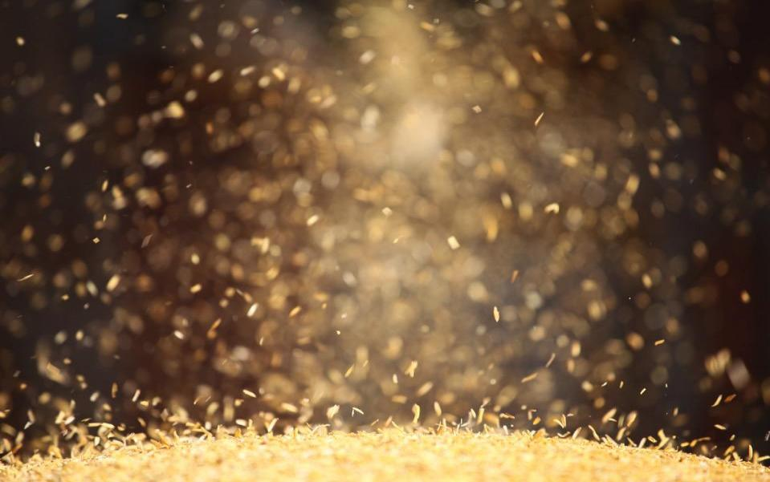
Key messages:
Transformation of rice value chains will be key to developing a sustainable food system, for which the Standard serves as a foundation
Proven technologies are available to enhance resource use efficiency and mitigate climate impacts in rice
Effective incentive mechanisms and farmer outreach are key to adoption of sustainable best practices
However….
Only a collaborative, scaled-up response can we reach our goal
Notes:
And it is indeed the collective nature and broad reach of the SRP that is key here.
Micro-meso-macro indicators needed to drive transformative change
Conversation concerns incentives at all 3 levels
Non-linearities (a typology?)
Use of existing integrative tools and models to create a methodology

Slide 25



Get updated
Facebook.com/Sustainablericeplatform
@UNEPAsiaPacific; #sustainablerice
www.unep.org/roap
www.sustainablerice.org

Slide 26


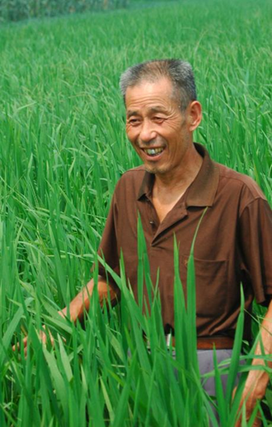
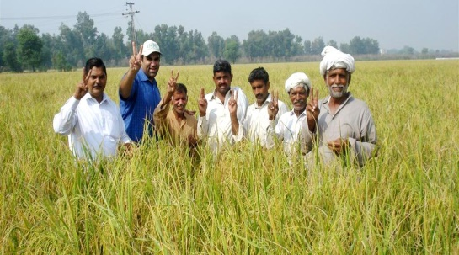
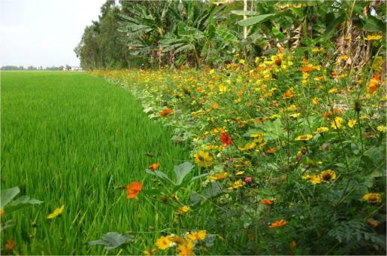
Thank you!

